Slide 1
Nouns:

Slide 2
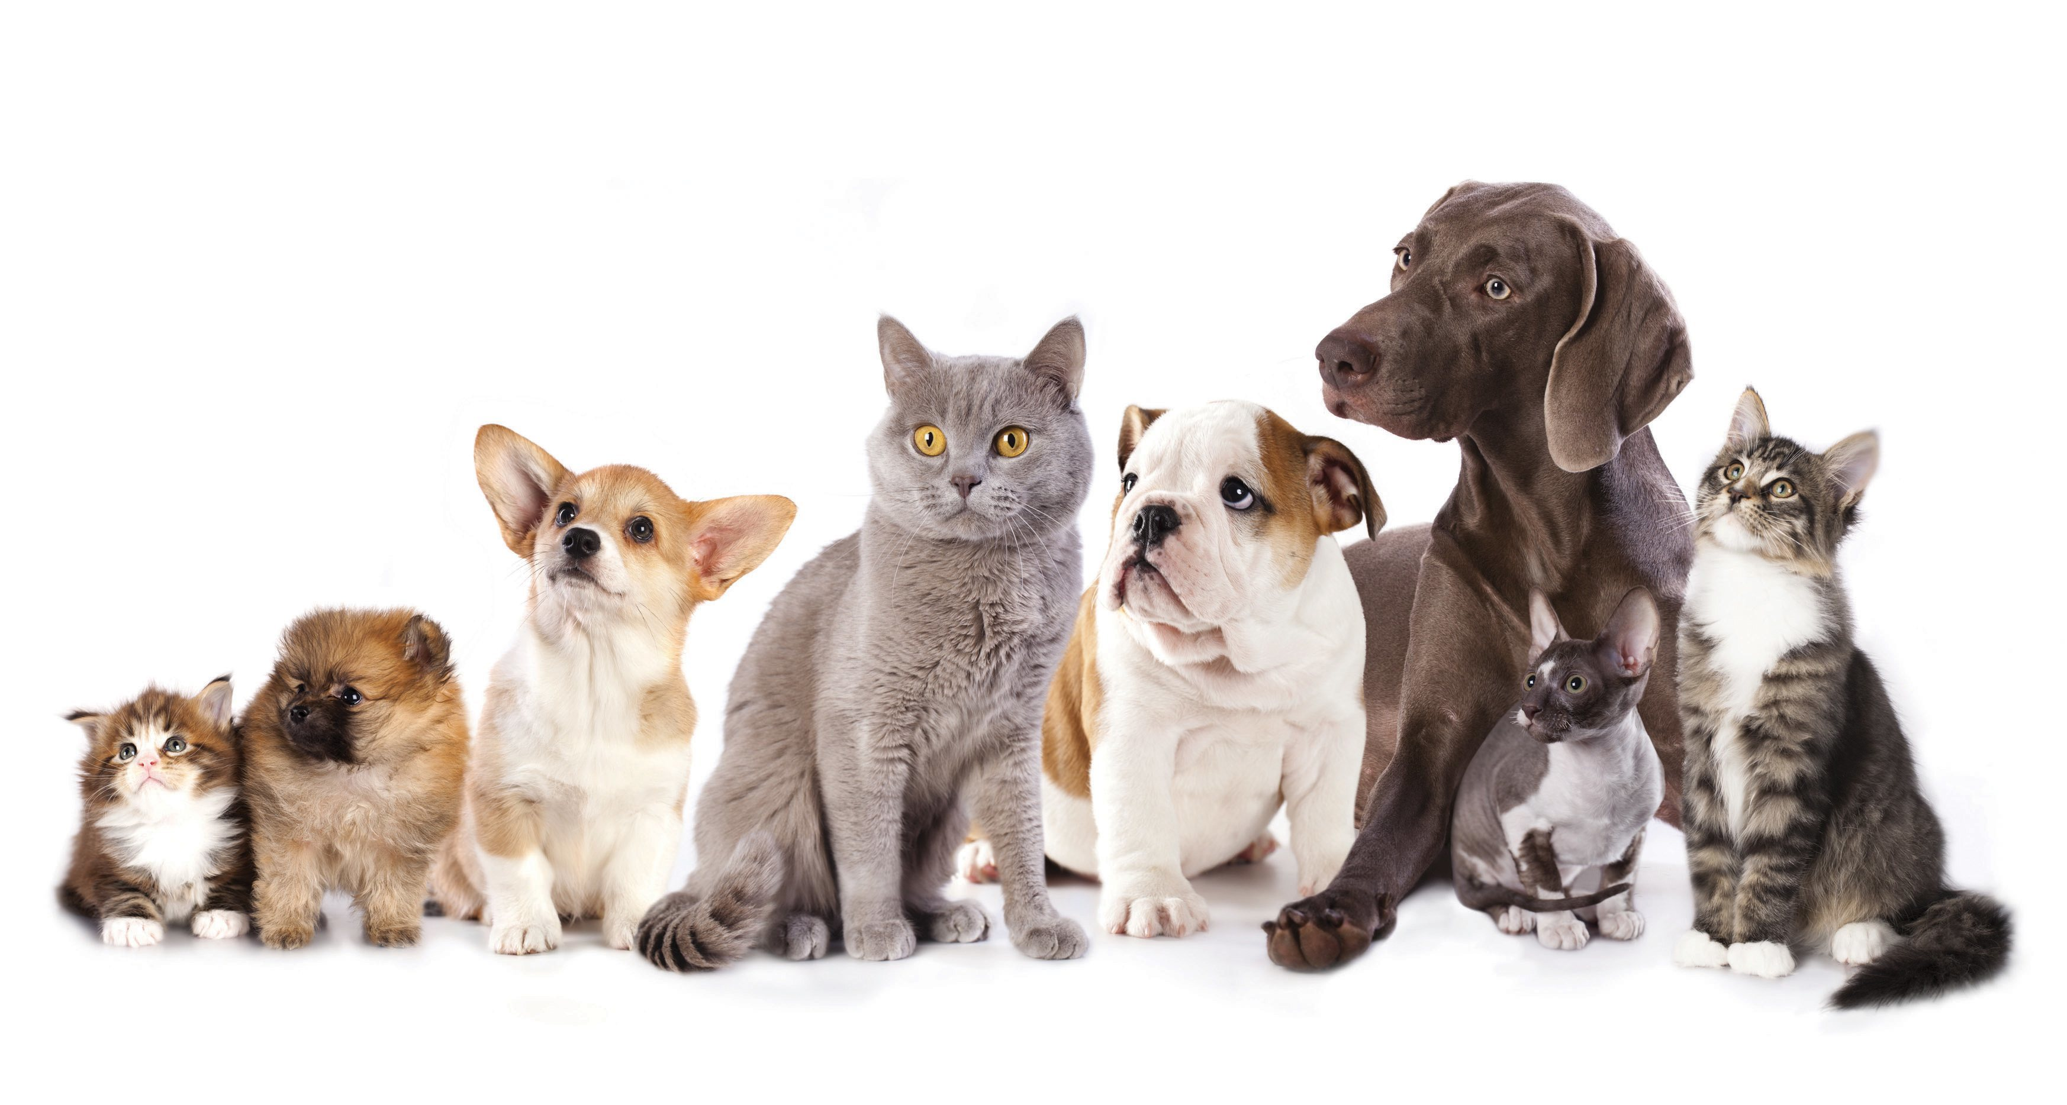
Singular > Plural: add 's'
cat > cats
dog > dogs
room > rooms
key > keys
café > cafés
DVD > DVDs
70 > 70s

Slide 3
Singular ending in sibilant (s/z/ch/sh/x) > add 'es'
bus > buses
watch > watches
wish > wishes
box > boxes
kiss > kisses

Slide 4
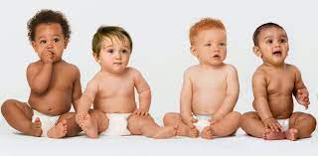
Singular ending in consonant + y > 'ies'
baby > babies
penny > pennies
city > cities
spy > spies
BUT: toy > toys

Slide 5
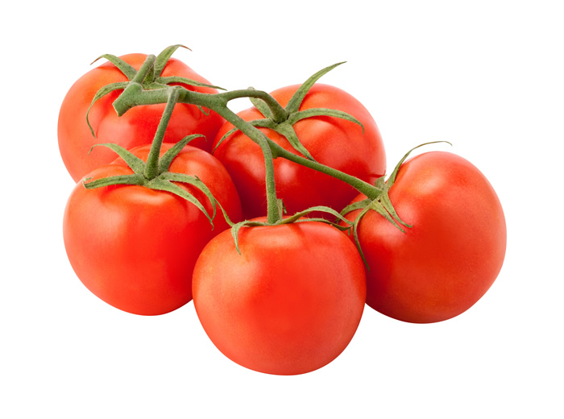
Singular words ending in –o:
consonant + o = oes
vowel + o = os
video > videos
patio > patios
radio > radios
stereo >stereos
potato > potatoes
tomato > tomatoes
hero > heroes
veto > vetoes
torpedo> torpedoes

Slide 6
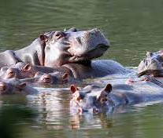
Singular words ending in –o:
exceptions:
photo > photos
solo > solos
hippo > hippos
piano > pianos

Slide 7
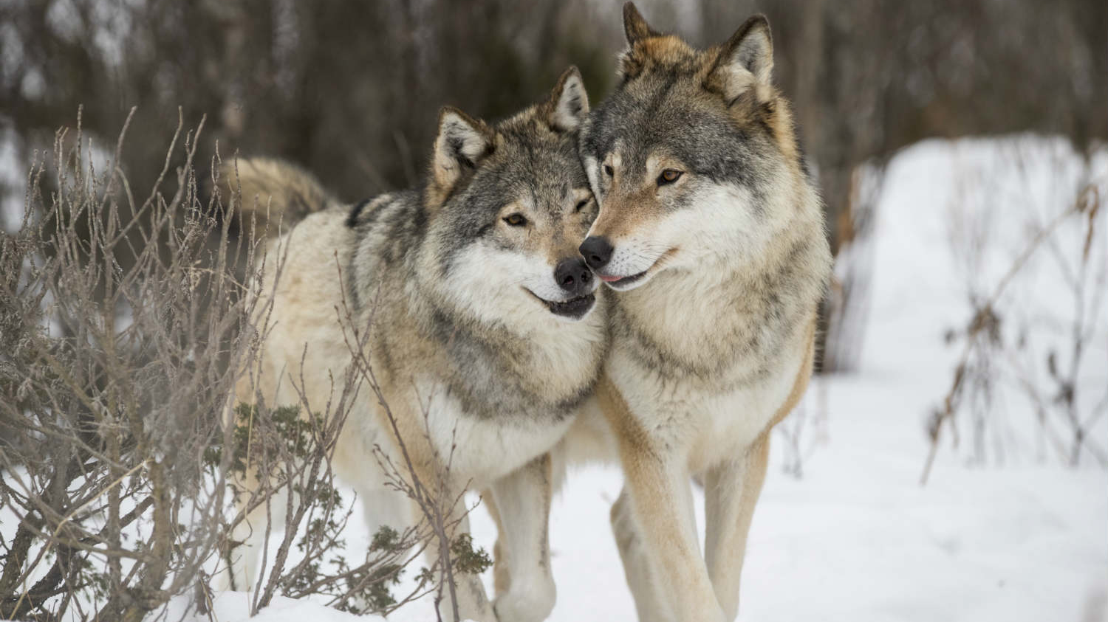
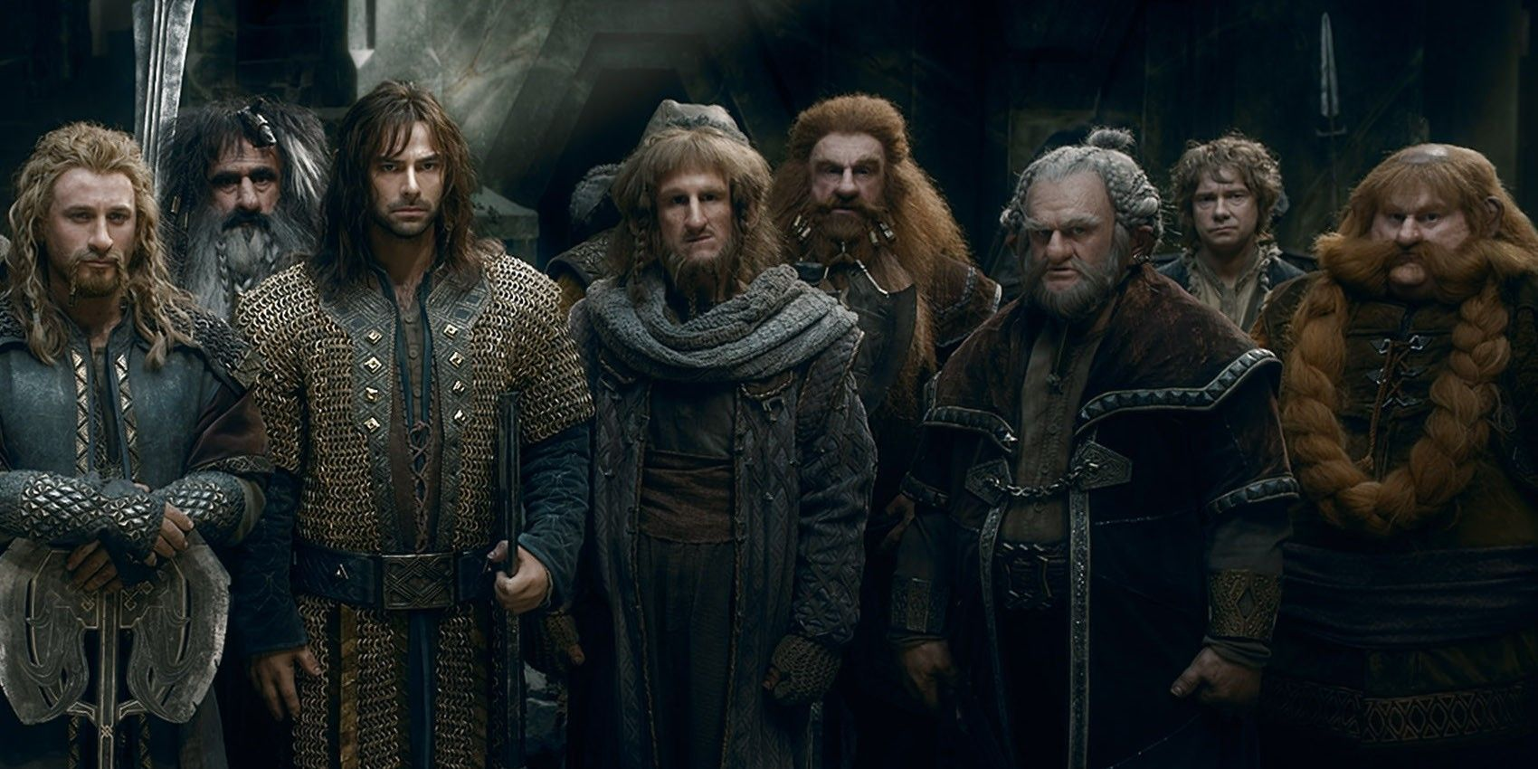
Singular ending in –f(e) > -ves
self > selves
wife > wives shelf > shelves
knife > knives leaf > leaves
wolf > wolves life > lives
thief > thieves loaf > loaves
half > halves hoof > hooves
dwarf > dwarves calf > calves
All other words in –f get –fs
roof > roofs

Slide 8
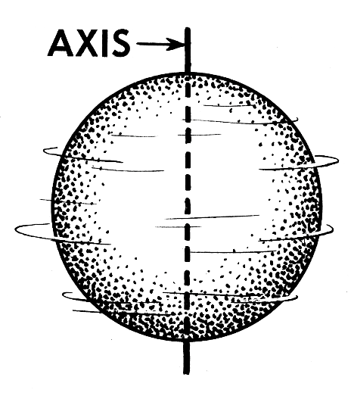
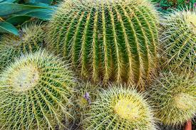
Latin or Greek words: words ending in –is get -es
words ending in -us get –i
cactus > cacti
fungus > fungi
crisis > crises
analysis > analyses
thesis > theses
axis > axes
parenthesis > parentheses
words ending in -on get -a
criterion > criteria
phenomenon > phenomena

Slide 9
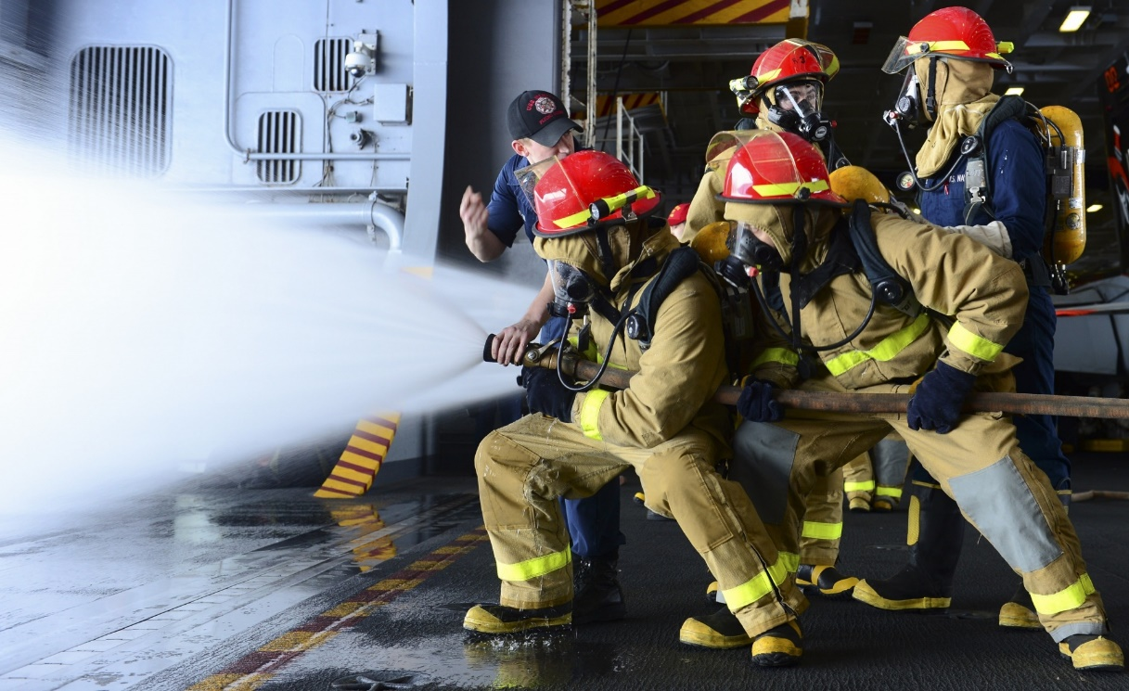
Irregular nouns:
man
> men
woman
> women
person
> people
child
> children

Slide 10
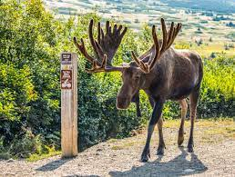
Irregular nouns:
sheep
> sheep
deer
> deer
fish
> fish
moose
> moose
buffalo
> buffalo
aircraft
> aircraft

Slide 11
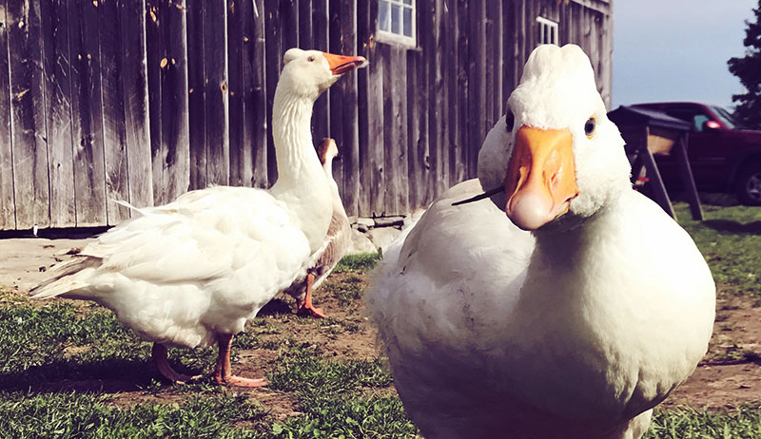
Irregular nouns:
goose
> geese
tooth
> teeth
foot
> feet

Slide 12
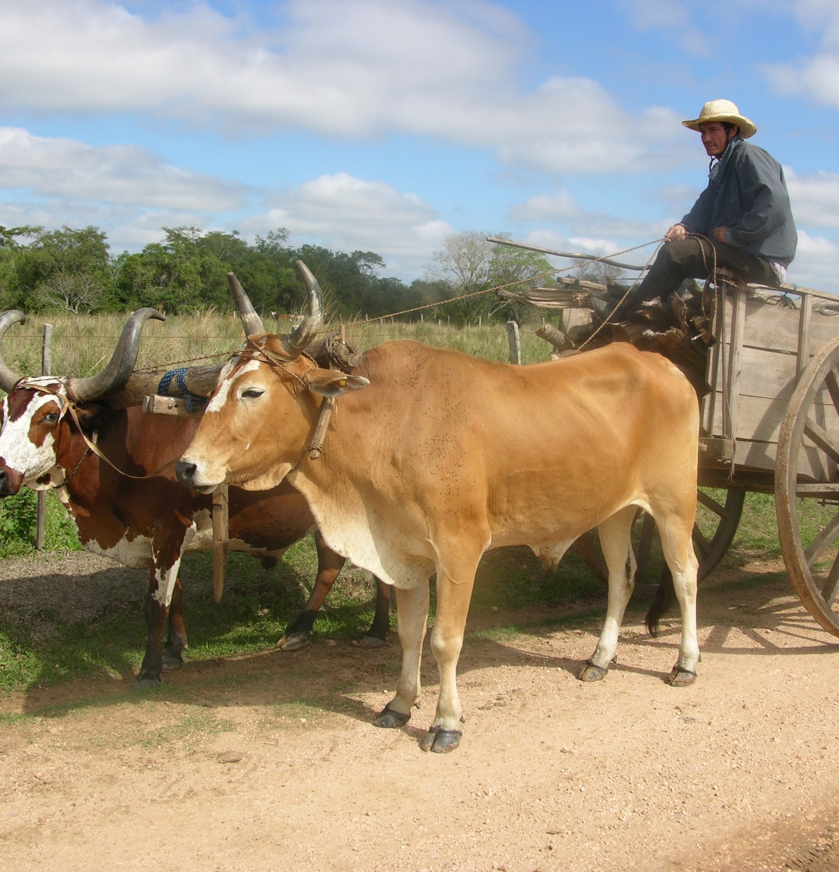
Irregular nouns:
mouse
> mice
louse
> lice
ox
> oxen

Slide 13
Words that are always plural:
police
audience
cattle
surroundings
series
contents
Make sure you always use a plural verb form with these words
The police are looking for the suspect.

Slide 14
Words that are always plural:
glasses, spectacles
trousers, shorts, jeans, pyjamas
scissors, binoculars, compasses
Use: “…. pair(s) of ….” if you want to indicate the exact number
I brought two pairs of jeans.

Slide 15
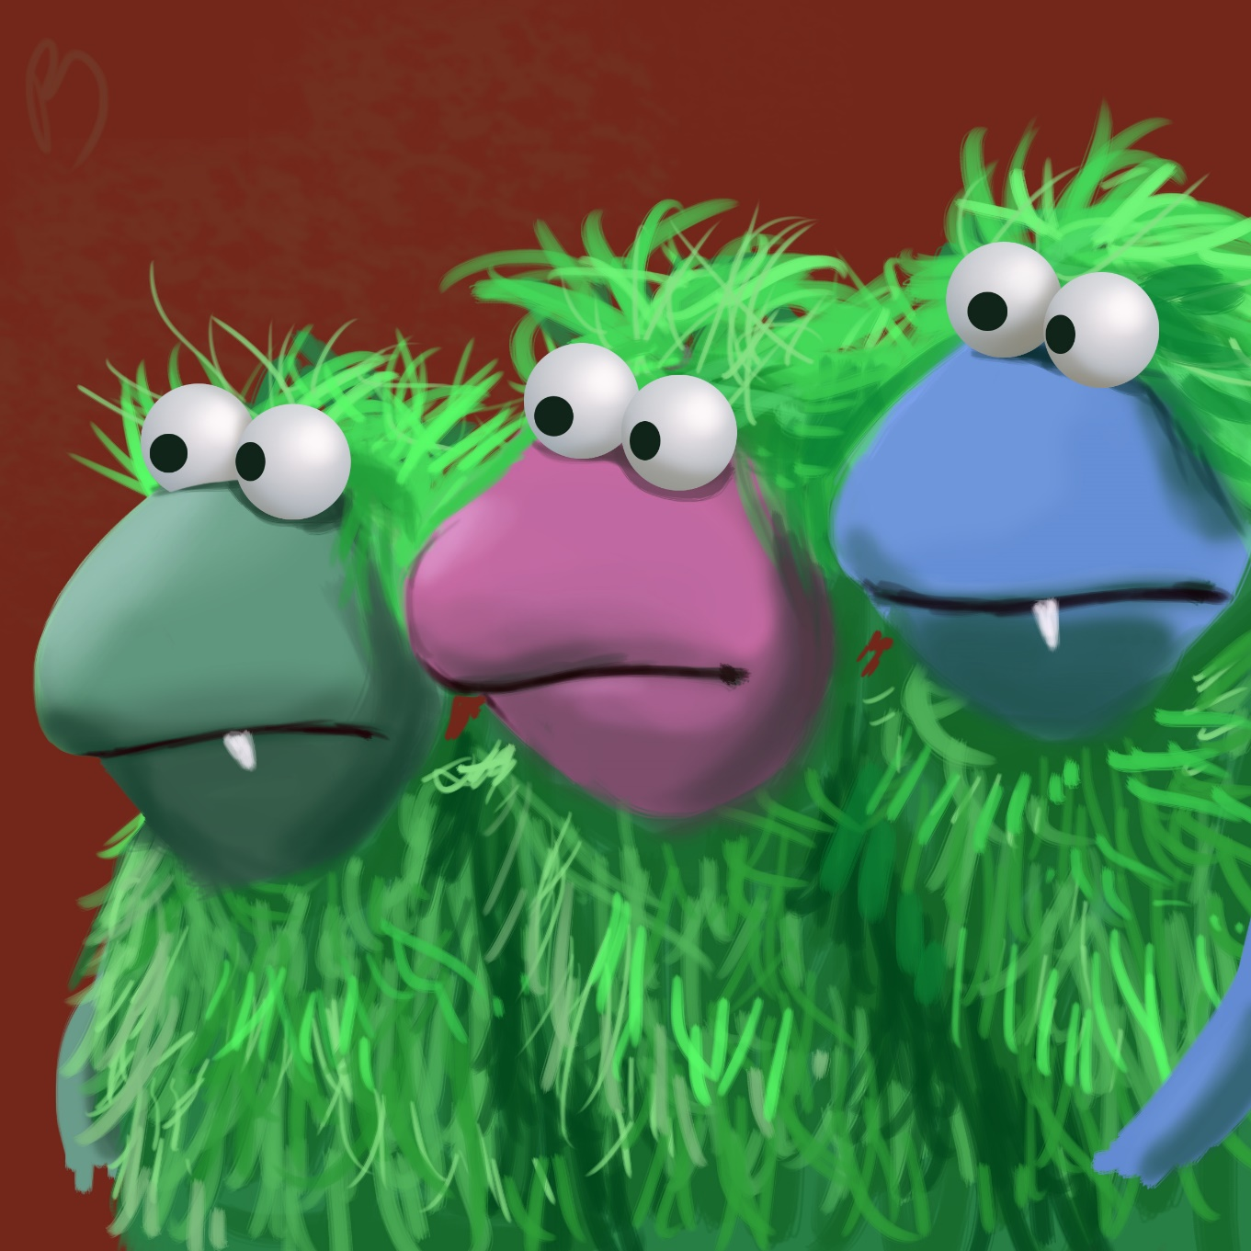
And remember:
Tom, Dick & Harry

